Slide 1
Coronavirus Trend
Domine: Health care

Slide 2
Team Members :
1)Venu Sai Ram Udayabhaskara 2)Rajashekar 3)Keval

Slide 3
Introduction:
We have examined 228993 records containing 33 columns of the covid data from the entire world.
Developed couple of logics which allows to solve the problem statements.
Performed data cleaning and preprocessing on top of the dataset.
With the help of that COVID dataset, we were able to extract some useful data.
Using this dataset, visualization and charts have been created.

Slide 4
Problem statements :
To discover the coronavirus trend on each continent in every year.
How many people in the entire world were COVID sufferers?
Which month and year are the highest for COVID cases in each continent?
Which month and year had the highest rates of COVID deaths in each continent?
To determine the status of each continent's vaccination trend.

Slide 5
Core Components:
For writing the code we have used
Python ,Pandas,SQL
For Executing the script used
Jupyter Notebook
Dataset references :India: Coronavirus Pandemic Country Profile - Our World in Data

Slide 6
Data Transformation:
Applied ARIMA model to forecast time series
Raw Dataset
Preprocessing Data
Data cleaning (Dedup , Junk)
Applied KNN model and Random Forest Classifier
Covid Dataset : 228993 records with 33 columns

Slide 7
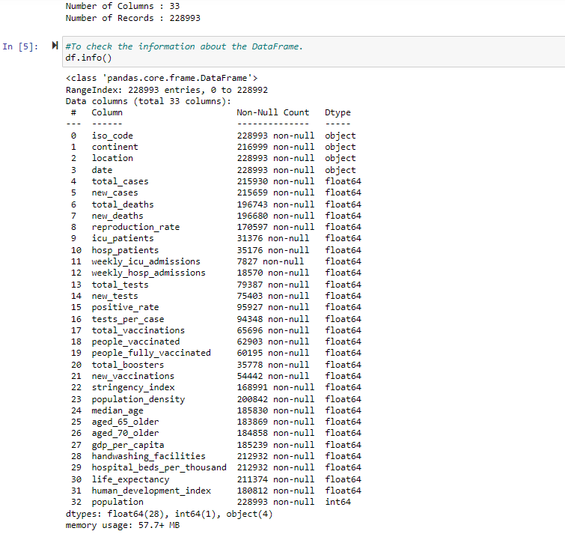

Slide 8
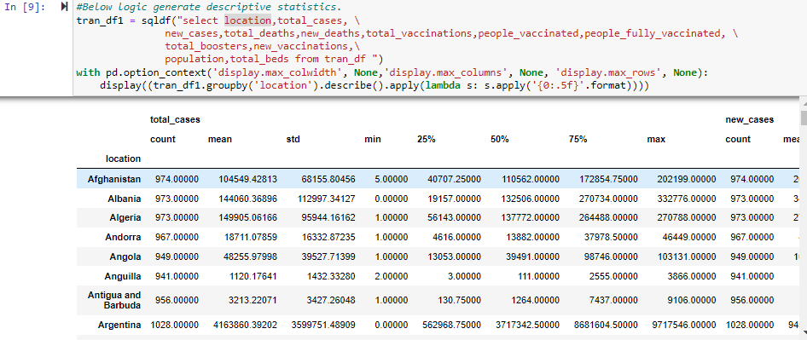

Slide 9
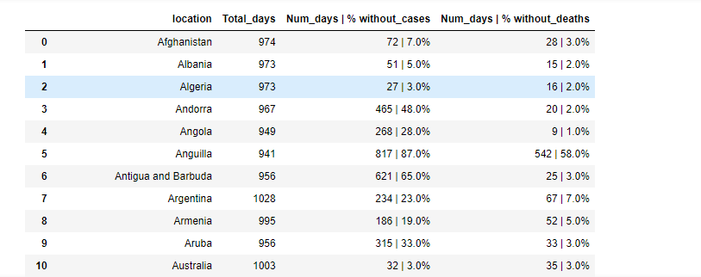

Slide 10
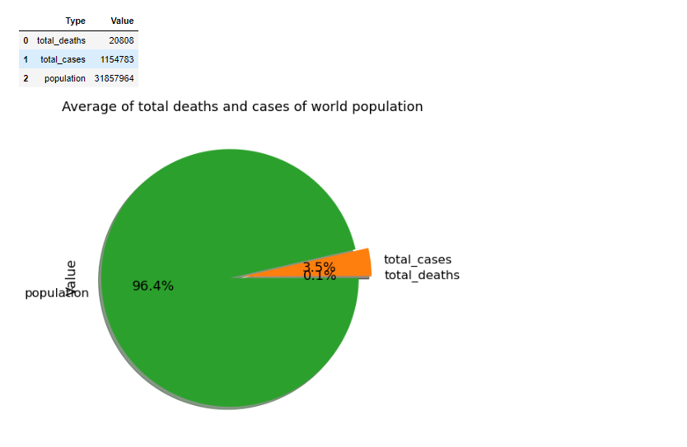

Slide 11
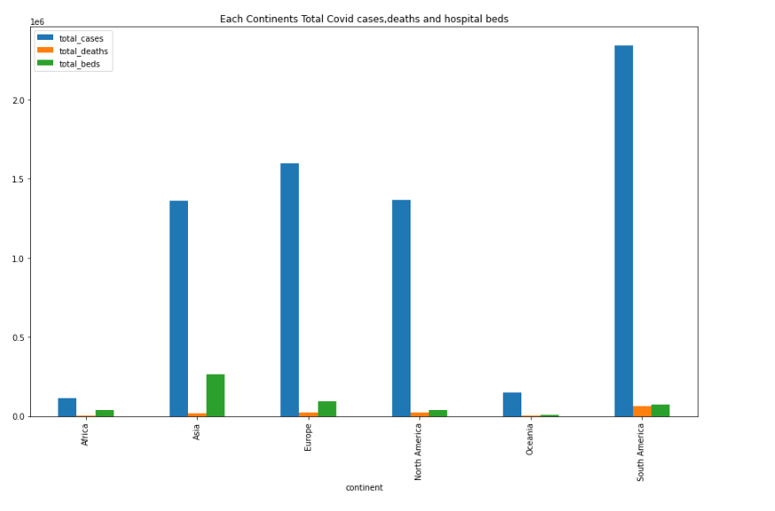

Slide 12
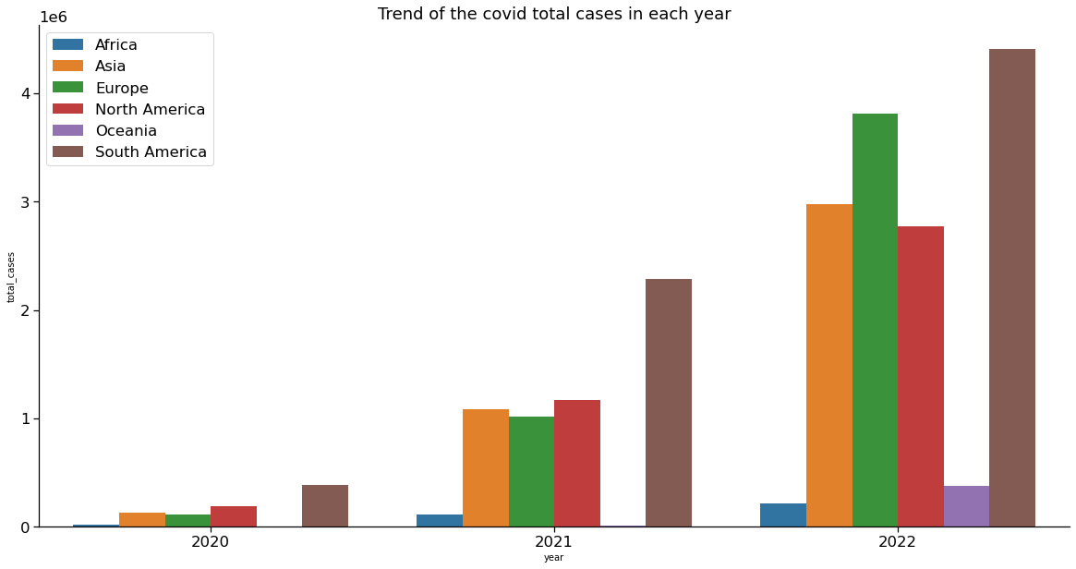

Slide 13
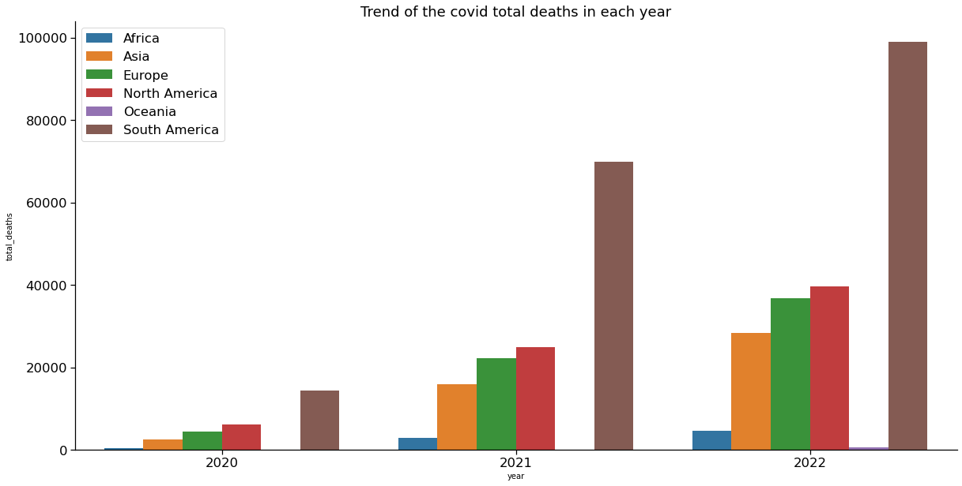

Slide 14
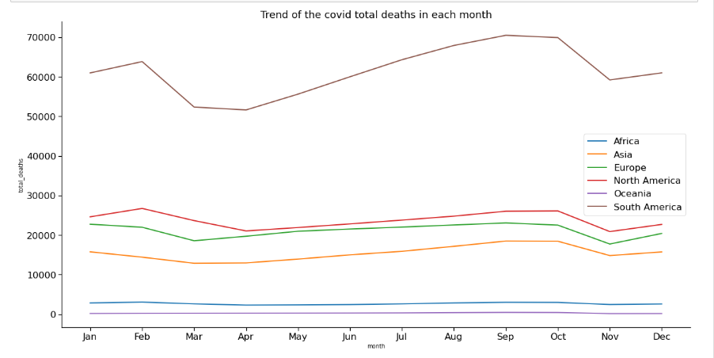

Slide 15
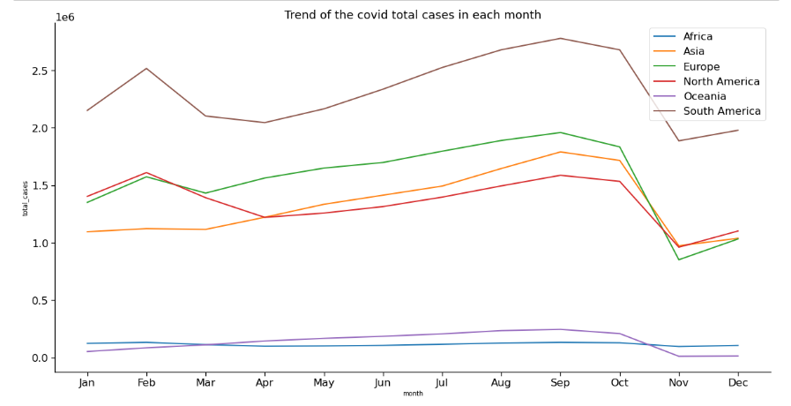

Slide 16
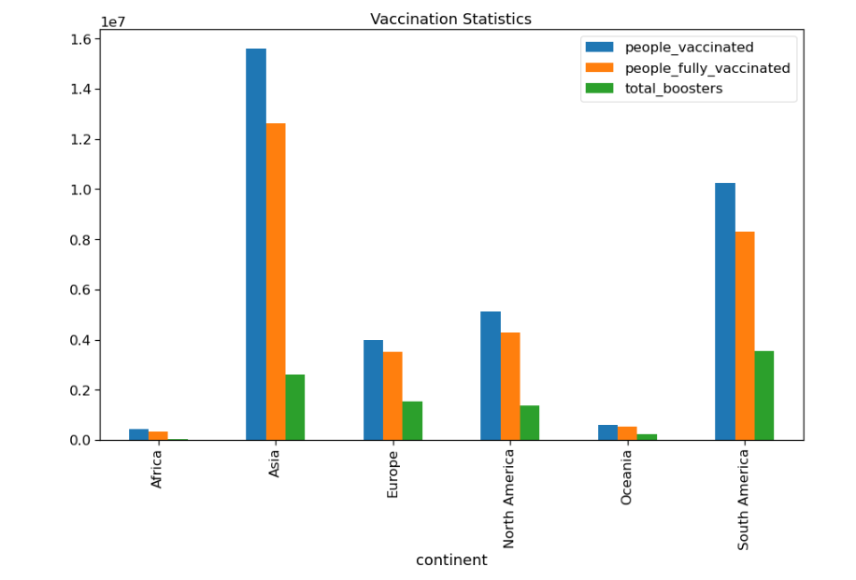

Slide 17
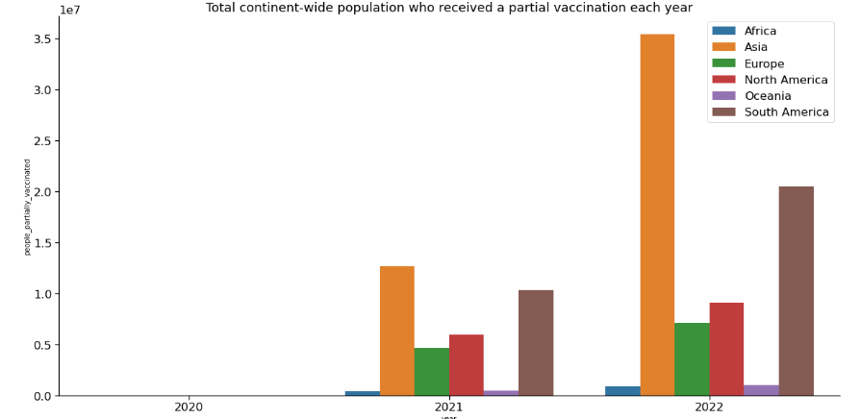

Slide 18
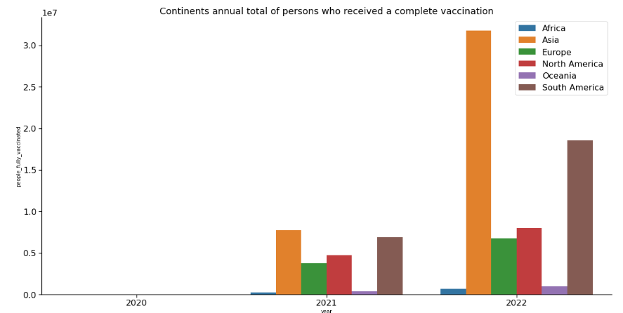

Slide 19
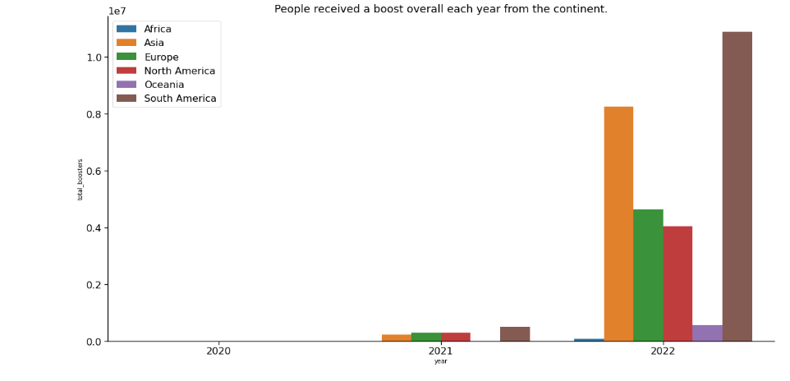

Slide 20
Thank You

